Slide 1
Detection of Global Warming in Texas
Crafted by:
Diego Bass

Slide 2
Project Scope
Detect global warming through:
Pollution data, Solar irradiance data, Meteorological data (air temperature)
Data Analysis:
Time-based data visualization, statistical, histograms, correlations, linear regressions. (Satellite data was not helpful)
Predictions?
An increase of temperature will be present, thus increasing amount of solar irradiance measured.
Caused by increase in measured pollution.

Slide 3
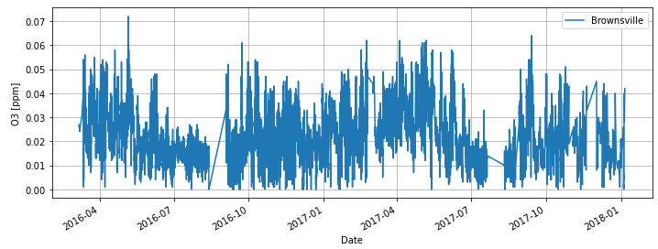
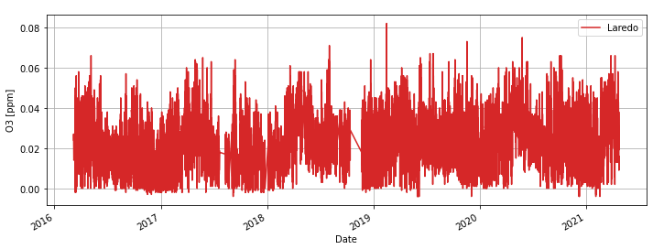
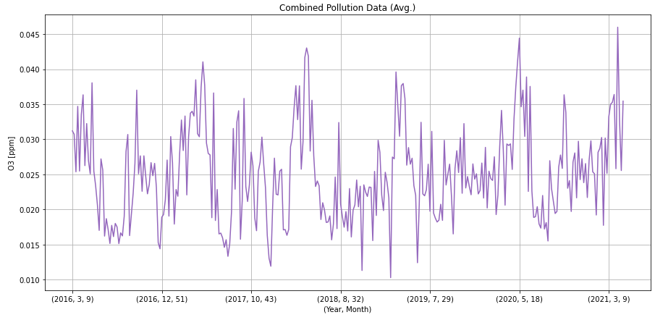
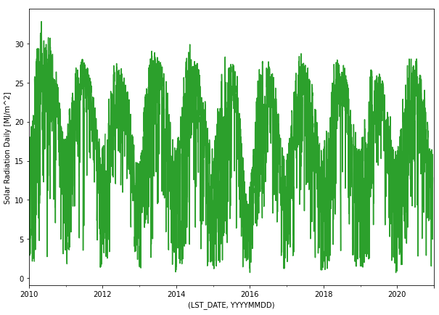
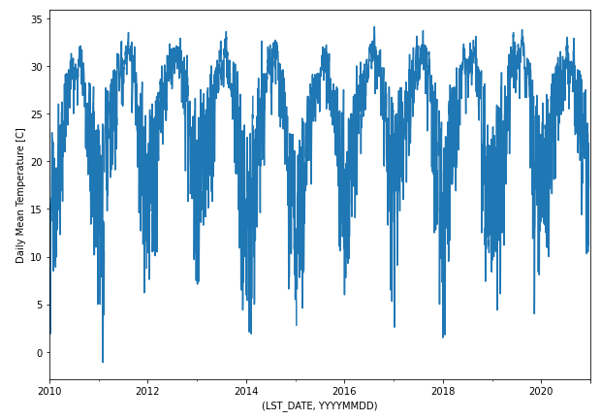
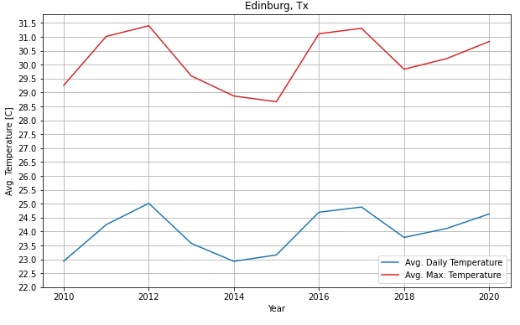
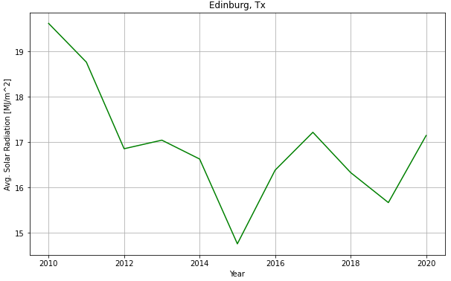
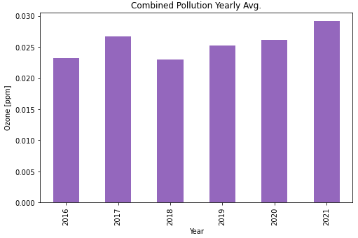
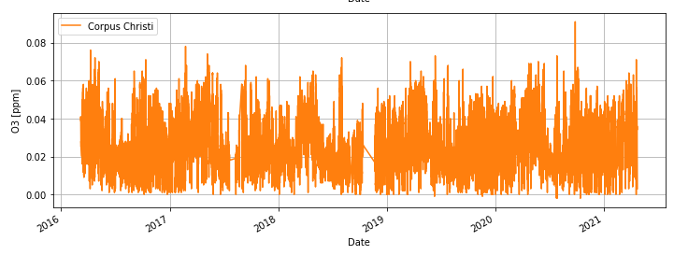
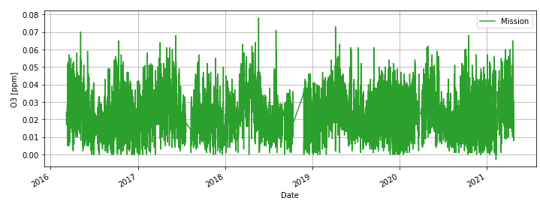
Data Visualization

Slide 4
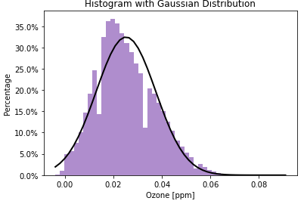
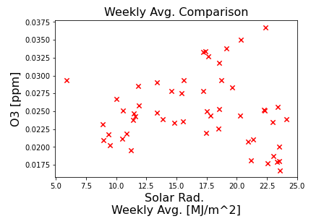
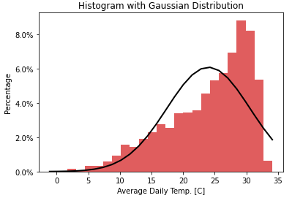
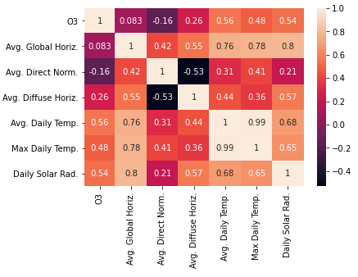
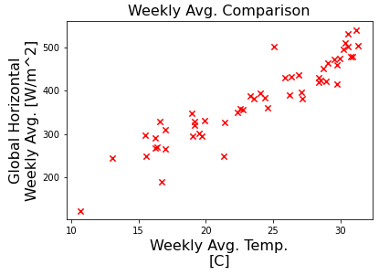
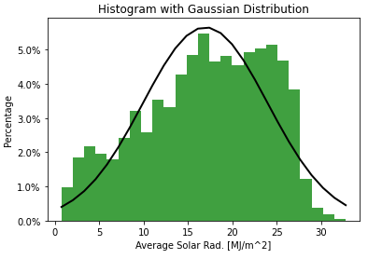
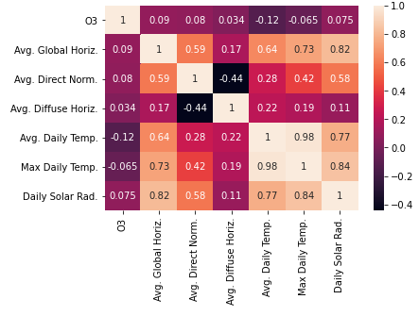
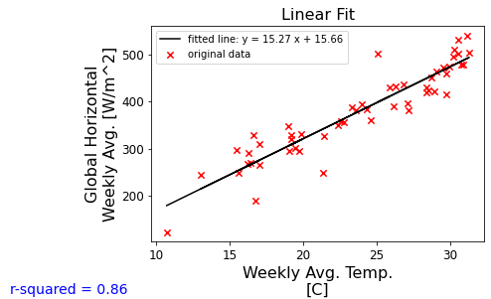
Data Analysis
Mean = 0.0252 ppm
Std. Dev. = ± 0.0122 ppm
Mean = 24 °C
Std. Dev. = ± 6.6 °C
Mean = 16.95 MJ/m^2
Std. Dev. = ± 7 MJ/m^2
Total Data Correlation
Yearly Avg. Correlation

Slide 5
Conclusion
Gradual increase in average temperature
Yearly avg. ozone data contained moderate correlation
Regression analysis not ideal
Average temperature contained high correlation with solar irradiance
Improvements?

Slide 6

Questions?

Slide 7
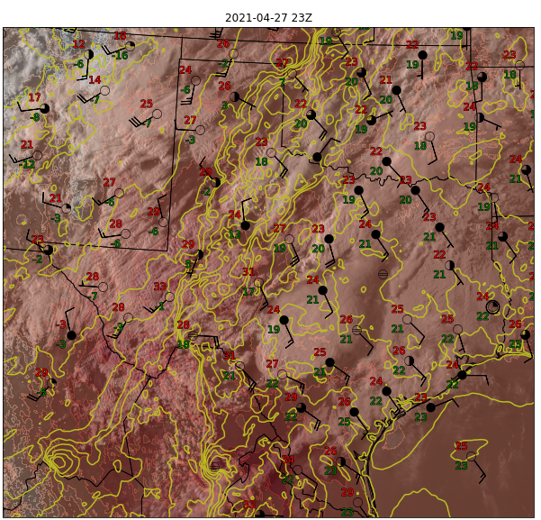
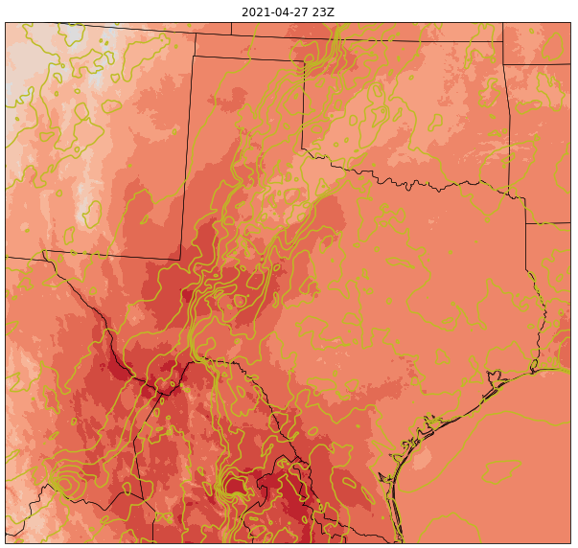
Satellite Visualization

